Slide 1
Application Summary
Travis sondgerath

Slide 2
Outline
Web application basics
Mobile application basics
Discuss the eTool in the context of above

Slide 3
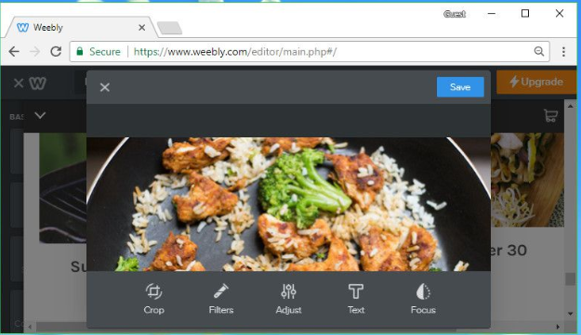


Web Applications

Slide 4
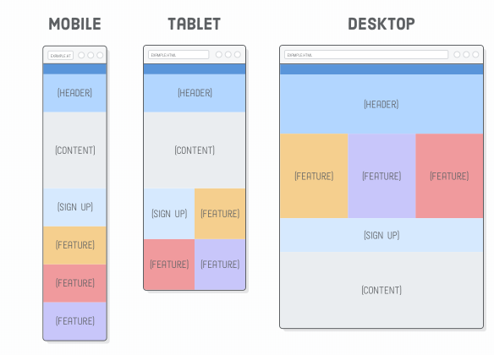
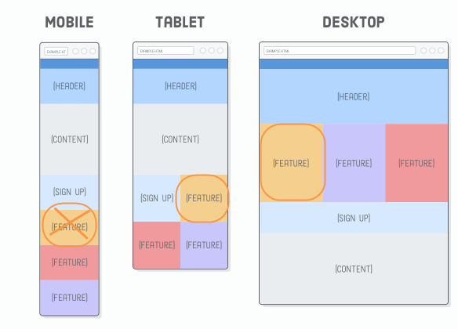
Layout Basics

Slide 5
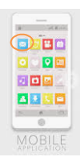
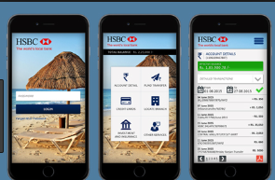
Mobile Applications

Slide 6
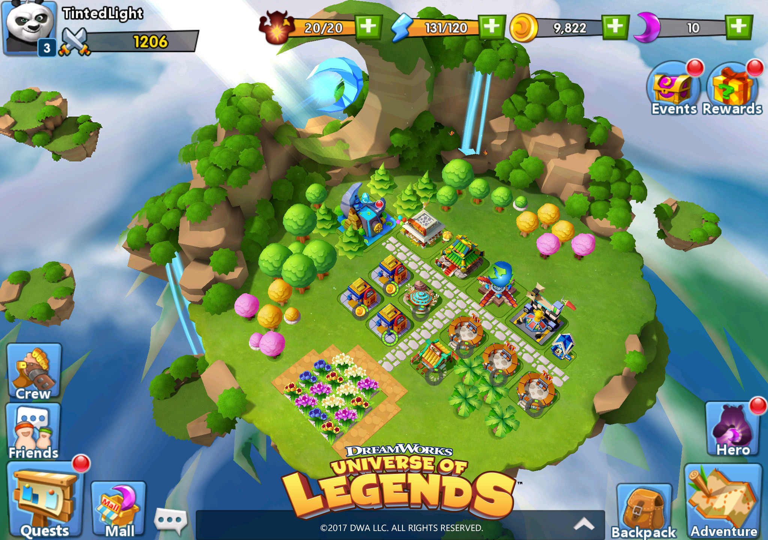
Mobile Applications

Slide 7
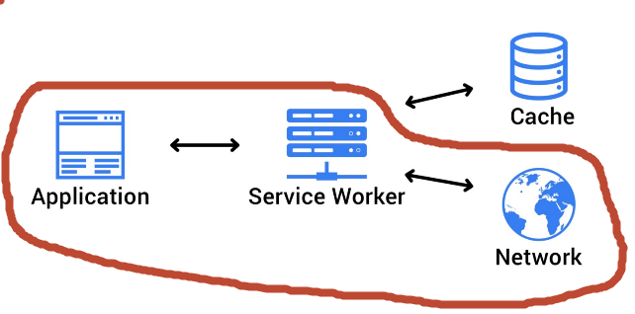
Offline Capable Mobile Applications

Slide 8
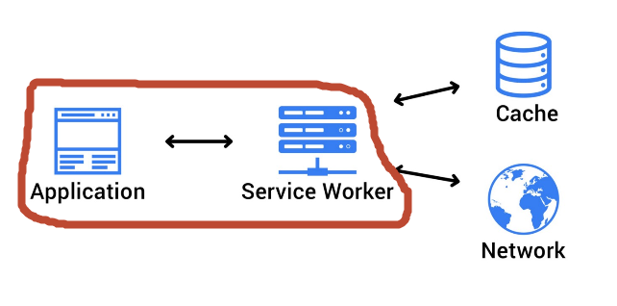
Offline Capable Mobile Applications

Slide 9
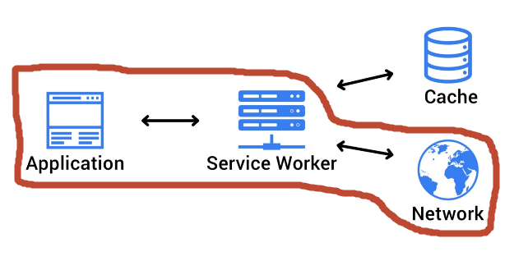
Offline Capable Mobile Applications
Loss of Internet Service?

Slide 10
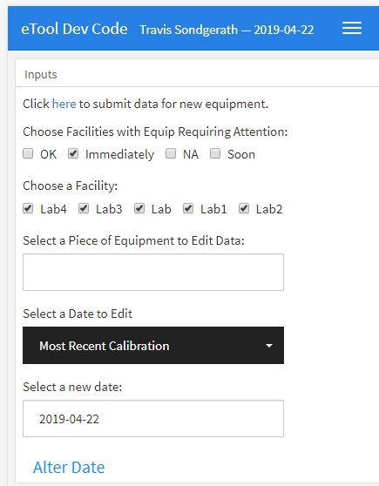

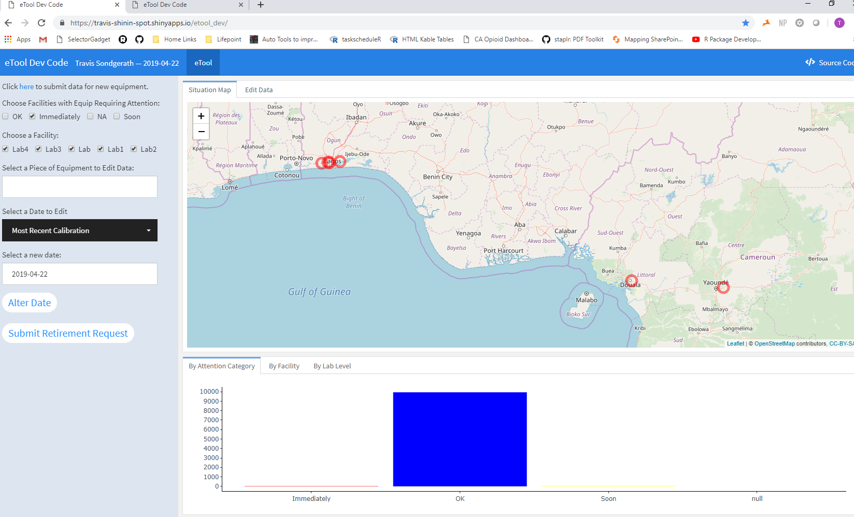
eTool in Context

